Slide 1


MARSians
AR and P-spice based Circuit Simulator

Slide 2


Simple Solutions for Complex Connections.

Slide 3

Theme
Organizational Problem Statement
Domain
Mixed and Augmented Reality Systems
Your Idea
AR and P-Spice based Circuit Simulator

Slide 4


Problem your idea solves
The circuit simulator we aim to create will be supported on all the platforms The circuit made on the 2D test system will be changed over into 3D interactable circuit. This will provide the user the 3D experience of the circuits and its components without paying for the hardware. This pandemic has downgraded the practical knowledge we students received. But NO More!!! This application will provide students with better practical experience in their education.

Slide 5

Novelty of Your Idea
There is no such product in the present education curriculum of Indian Institutions that has an implementation like ours. And that too using the AR/VR technology our application will provide quality interaction with the 3D model that the user will be working on. Its no less than working with real circuit components.
Social Application
It will help students with poor financial background who cannot afford to go to schools or colleges. This will help students understand their practicals even in online classes. For the students like us whose education have been compromised due to this pandemic will no longer lack the practical knowledge using this application.
Business Application
The global augmented reality (AR) market is expected to grow at a compound annual growth rate of 74.9% from 2016 to 2024 to reach USD 100.2 billion by 2024.
As you can see the market of AR is growing at a phenomenal rate , there is a sea of opportunities for this application to become a new method of education. The world is taking its visual leap ripping the barrier between real and virtual.

Slide 6

Step 1 We first pointed out the problem that we as engineering students were facing of not being able to receive the practical education that we were suppose to. So our plan was to create an environment with the help of AR to solve this problem.
Approach to
solution
A simple timeline on how your solution came to be is a helpful way of visualizing your origin story. What frustrations or ideas led to this? and how will you implement this?
Step 2
We aimed to create an environment that will enable user to interact with 3D model as if they were real objects
Step 3
Now being an electronics branch students we thought to enhance the circuit simulator software by creating a 3D alternative that will give the user the real experience with virtual models.

Slide 7

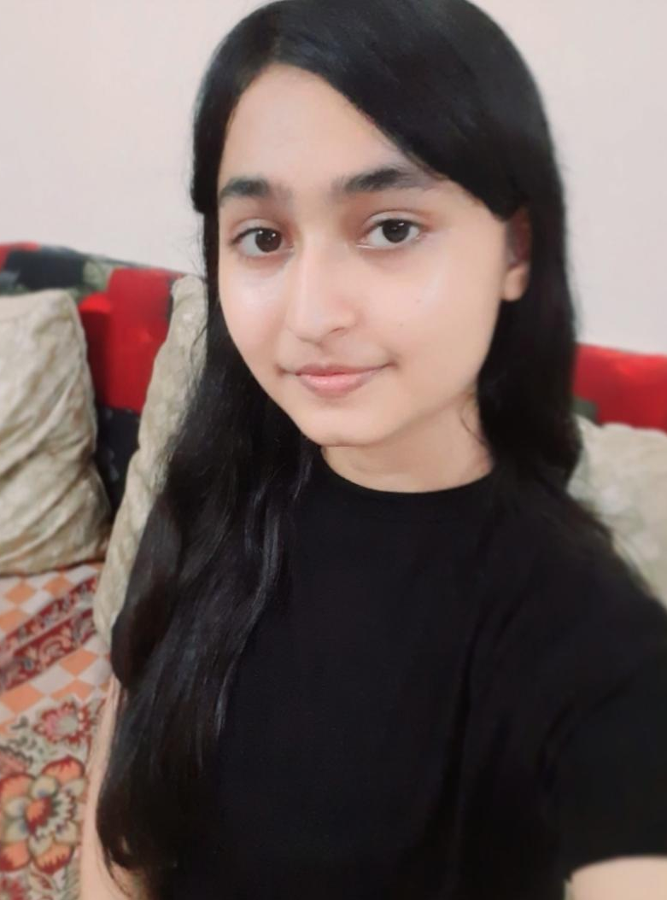
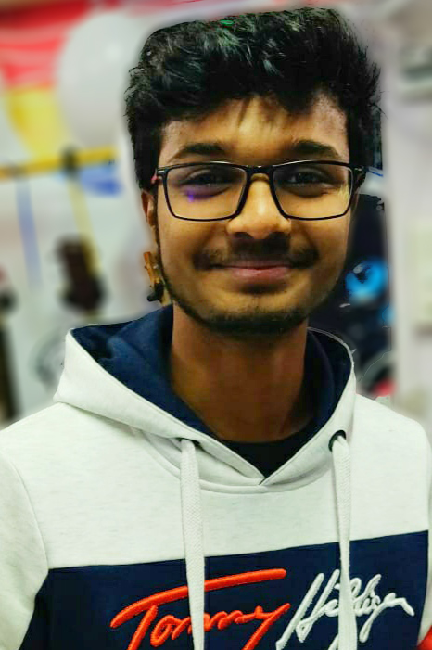

MARSians
Amit Chawla
Chitra Bhartiya
Swagat Raj
Jaswant Yadav

Slide 8

Contact Us
+91 7340579501
amitchawla1320@gmail.com

